Slide 1
Introduction to Software Engineering
Contents :
1 Overview of Software Engineering
2 Evolution and Impact of Software Engineering
3 Software Development Life Cycle (SDLC)
Life-Cycle Models
Waterfall Model
Prototype Model
Evolution and Spiral Model
4 Feasibility Study
5 Functional and Non-Functional Requirements
6 Requirement Gathering
7 Requirement Analysis and Specification.

Slide 2
Overview of Software Engineering
What is Software Engineering?
Software engineering is the branch of computer science that deals with the design, development, testing, and maintenance of software applications.
The term software engineering is the product of two words, software, and engineering.

Slide 3
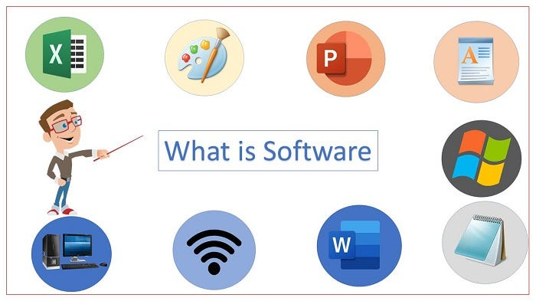
What is a Software ?
The software is a collection of integrated programs.
Engineering is the application of scientific and practical knowledge to invent, design, build, maintain, and improve frameworks, processes, etc.

Slide 4
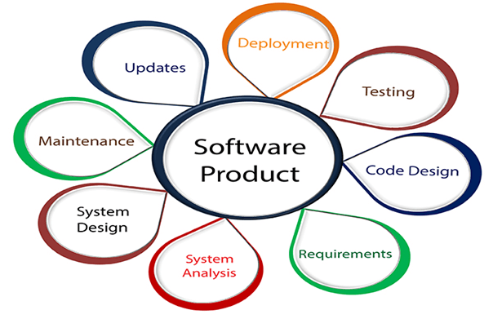
Software Engineering is an engineering branch related to the evolution of software product using well-defined scientific principles, techniques, and procedures.
The outcome of software engineering is an efficient and reliable software product.

Slide 5
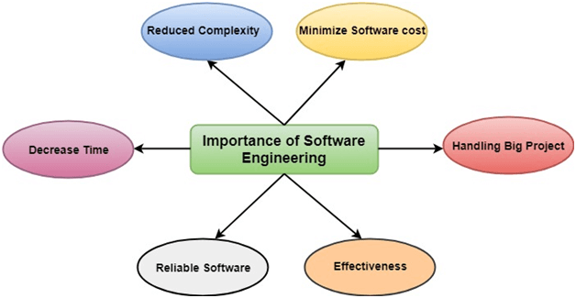
Why is Software Engineering required?
Software Engineering is required due to the following reasons:
To manage Large software
For more Scalability
Cost Management
To manage the dynamic nature of software
For better quality Management

Slide 6
Evolution and Impact of Software Engineering
What is Software Evolution ?
Software Evolution is a term that refers to the process of developing software initially, and then timely updating it for various reasons, i.e., to add new features or to remove obsolete functionalities, etc.
The process of developing a software product using software engineering principles and methods is referred to as software evolution.

Slide 7
Step-by-Step Process of Software Evolution
Software engineering as an art
Software engineering transition from art to craft
Software engineering transition from craft to an engineering discipline

Slide 8
Contd..
Software engineering as an art: refers to the creative and intuitive aspect of software development.
Programmers would often write code in an ad-hoc manner without much structure or planning, and the final product was often the result of their personal artistic expression.
However, traditional ad-hoc approach to software development is not sufficient as software systems are becoming complex.

Slide 9
Contd:
Software Engineering Transition from Art to Craft:
This led to the emergence of the field of software engineering, which focused on bringing more structure and discipline to the software development process.
Software Engineering transformed from Art to Craft when the area of people who know Software Designing and Coding will increase.
the focus shifted from the artistic expression to individual programmers.

Slide 10
Contd..
to use established processes and methodologies to ensure the quality and reliability of software systems
software development has become more structured and discipline.
Software engineering transition from craft to an engineering discipline
the focus has shifted to a more scientific and systematic approach to software development
This has led to the development of new techniques and methodologies such as formal methods, model-driven development, and software architecture.

Slide 11
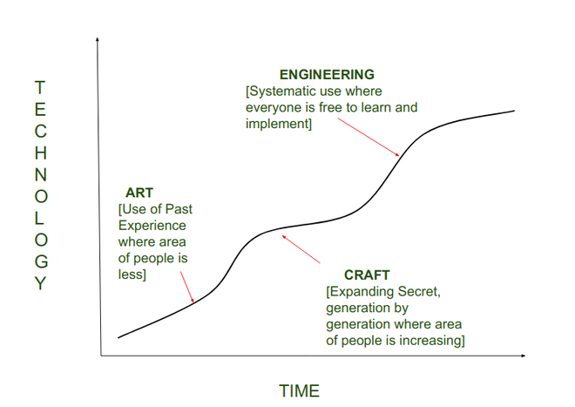
Contd..
In today’s world Software Engineering acts as an Engineering Discipline when everyone can learn Software designing and coding irrespective of that they are pursuing a degree or not.

Slide 12
Impact of Software Engineering
Key areas where software engineering has made a significant impact:
Technological Advancements:
It has led to the development of new technologies, platforms, and tools that continue to shape and transform industries.
Communication and Connectivity:
The development of the internet, email, social media, and various communication tools has revolutionized the way people interact, collaborate, and share information across the globe.
Automation and Efficiency:
Automation reduces manual errors, enhances productivity, and allows organizations to operate more smoothly.

Slide 13
ACTIVITY?
A CASE STUDY ON “ Evolution of Web Browsers”
Goal is to gain how software engineering is evolving in modern era
Background :
The evolution of web browsers, from early text-based browsers to modern, feature-rich applications like Chrome, Firefox, and Safari.

Slide 14
Objectives of the Case Study
Trace the Historical Evolution:Examine the historical development of web browsers, starting from early text-based browsers (e.g., Lynx) to graphical browsers (e.g., Mosaic, Netscape) and the modern browsers (e.g., Chrome, Firefox, Safari, Edge).
Explore Technological Advancements:
Evaluate User Experience Enhancements:
Examine Security and Privacy Considerations

Slide 15
Contd:
Discussing Standardization Efforts
Predict Future Trends

Slide 16
Software Development Life-Cycle
A software life cycle model (also termed process model) is a pictorial and diagrammatic representation of the software life cycle.
A life cycle model represents all the methods required to make a software product transit through its life cycle stages. It also captures the structure in which these methods are to be undertaken.
SDLC provides a well-structured flow of phases that help an organization to quickly produce high-quality software which is well-tested and ready for production use

Slide 17
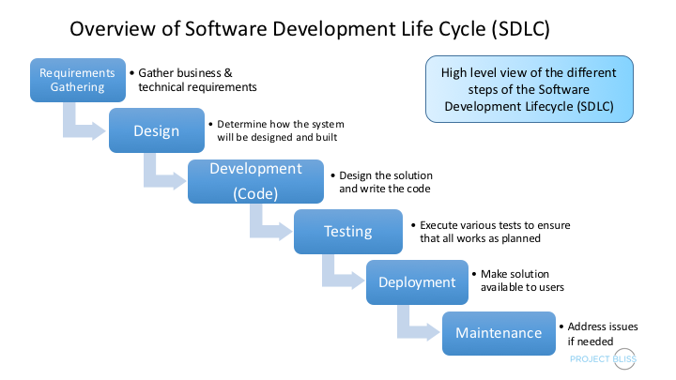
HOW SDLC WORKS?

Slide 18
Life-Cycle Models
Life cycle models are systematic approaches to understanding the development and evolution of a system or project over time.
These models provide a structured framework for planning, designing, implementing, testing, deploying, and maintaining systems
Types of Life-Cycle Models:
Waterfall Model
Prototype Model
Evolution and Spiral Model

Slide 19
Waterfall Model
The Waterfall Model is a linear and sequential approach to software development, where the progress is seen as flowing steadily downwards (like a waterfall) through several distinct phases
It is one of the oldest and most straightforward software development life cycle models
The key characteristic of the Waterfall Model is that progress is seen as flowing in one direction through these phases, and each phase must be completed before the next one begins.

Slide 20
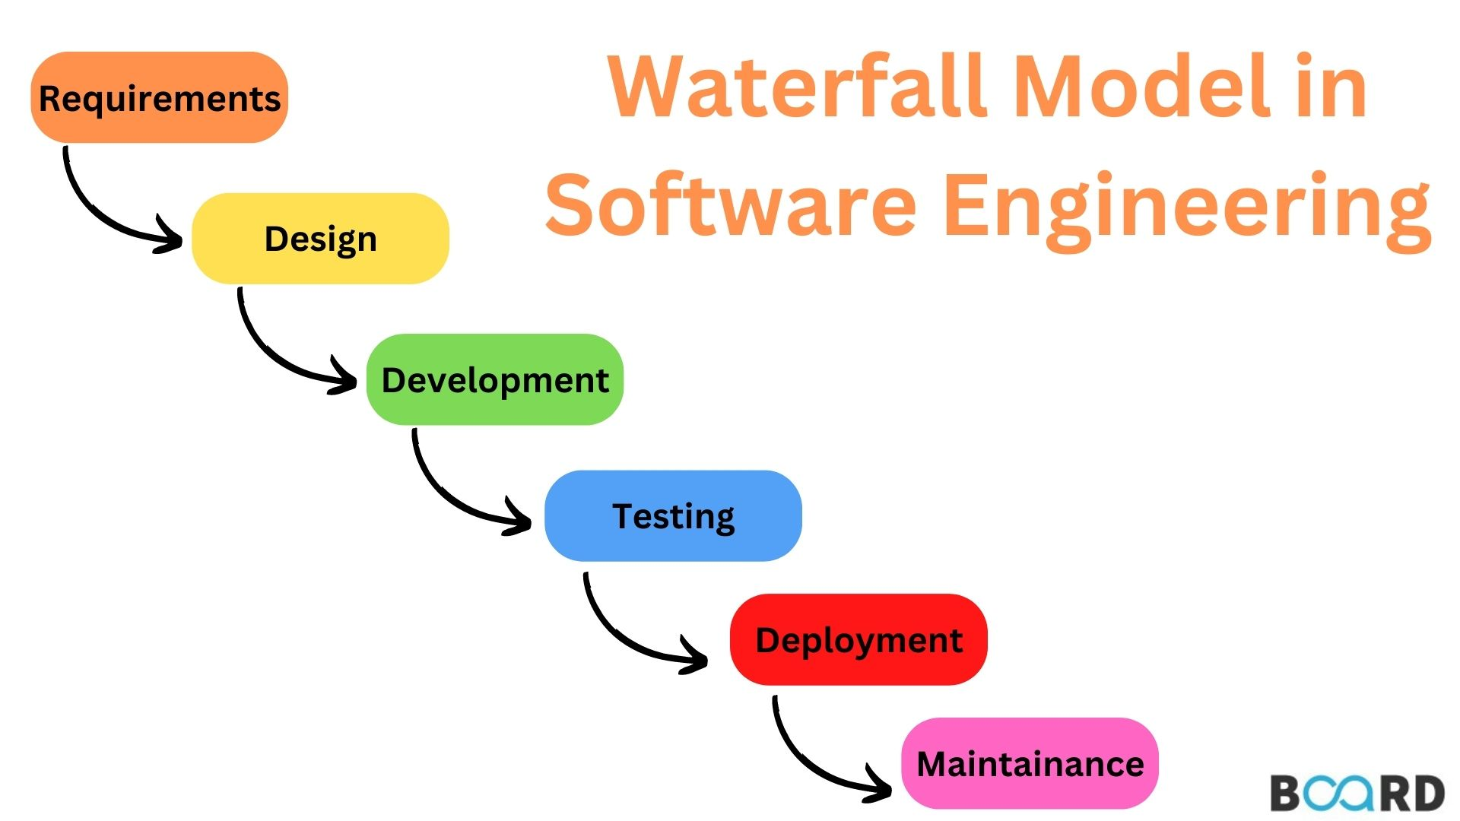
Contd..

Slide 21
Contd..
Requirements Gathering and Analysis:
In this initial phase, project stakeholders, including clients and end-users, are interviewed to gather and document their requirements.
The requirements are analyzed to ensure clarity, completeness, and feasibility. A detailed understanding of the project's goals and scope is established.

Slide 22
Contd..
System Design:
Based on the requirements gathered, system architects and designers create a high-level system architecture and design specifications.
This phase involves defining system components, their relationships, and the overall system architecture. It serves as a blueprint for the subsequent phases.

Slide 23
Contd..
Implementation (Coding):
The actual coding or programming of the software is carried out in this phase.
Developers write code according to the design specifications, following coding standards and best practices.

Slide 24
Contd..
Testing:
Once the code is implemented, the system undergoes testing to detect and fix any defects or bugs.
Various testing techniques, such as unit testing, integration testing, and system testing, are performed to ensure the software meets the specified requirements.

Slide 25
Contd..
Deployment:
After successful testing, the software is deployed or released to the production environment for use by end-users.
Deployment may involve activities such as data migration, user training, and setting up the necessary infrastructure.

Slide 26
Contd..
Maintenance:
The maintenance phase involves ongoing support and updates to the software to address any issues that may arise in the operational environment.
Changes and enhancements may be made to meet evolving user needs or to adapt to changes in the external environment.

Slide 27
Example of Waterfall-Model
Let's take the example of manufacturing a car:
Requirements Phase:
  Define the specifications and requirements for the car, including the model, features, performance, and any specific customer preferences.
Design Phase:
  Develop detailed engineering and design plans for the car based on the established requirements. This includes creating blueprints, schematics, and specifications for each component.
Implementation (Manufacturing) Phase:
  Begin the actual manufacturing of the car based on the approved designs. This phase involves the sequential assembly of various components, such as the chassis, engine, transmission, and interior, on an assembly line.
Testing Phase:
  Conduct rigorous testing on the assembled car to ensure that it meets quality and safety standards. This involves various tests, including performance testing, safety testing, and quality assurance checks.
Deployment (Delivery) Phase:
  Once the car passes all tests and inspections, it is ready for delivery to customers or dealerships. The finished product is handed over to the end-users.

Slide 28
Contd..
6.Maintenance and Support Phase:
  After the car is in use, ongoing maintenance and support are provided. This could include warranty services, recalls for identified issues, and routine maintenance recommended for optimal performance.

